Slide 1


Audio/Video System
Quick Reference Guide
Auditorium/Café

Slide 2


Welcome Page
When approaching the control panel it may be blank. Touch anywhere on the display section to bring up the start page.
To use the Display System press and hold Anywhere on the Page For Three Seconds and Enter in the Code “1919”.

Slide 3
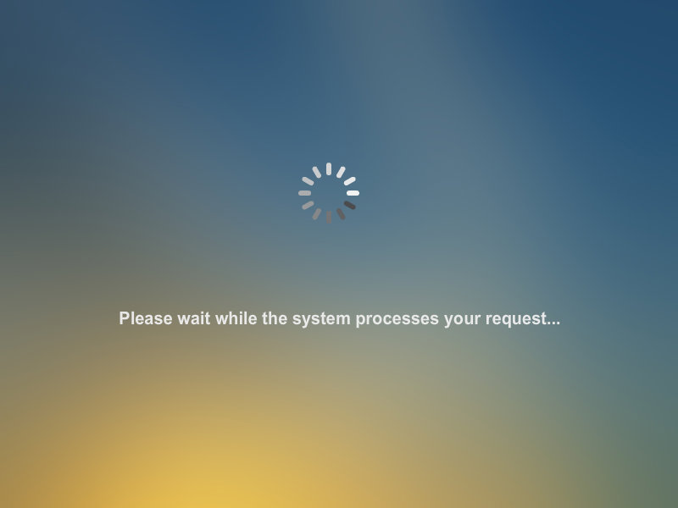
Wait Page
After Starting the System, The Wait Page will appear. During this time the Screen will drop, the Projector lift will come down from the ceiling and the Projector will Power On.

Slide 4
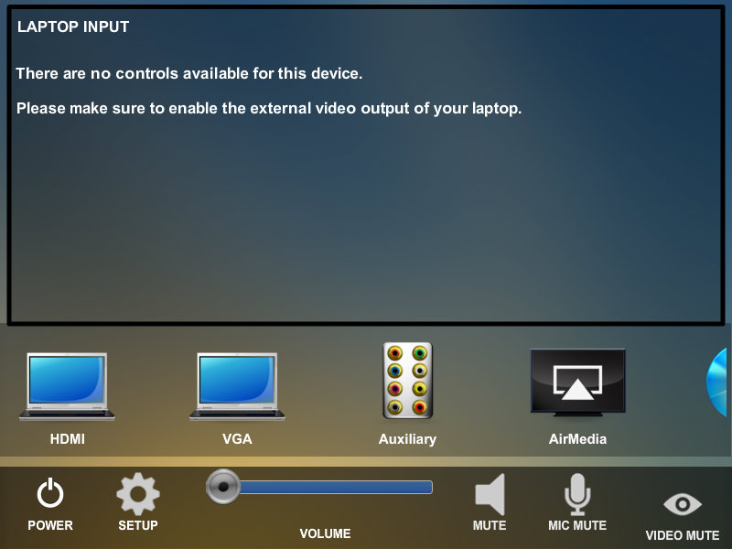
Main Page
Sources
Brings up the Confirmation Page
Mutes the Projector Video
Mutes Microphone Audio
Brings up the Setup Page
Controls the Program Volume
Mutes Program Audio
After the System Powers On, the Main Page Appears. Here you can select the Source you want to see on the Projector, access the Setup Page, Raise and Lower the Program Audio, Mute and Unmute the Microphones, and select the Aux Plate near the Cash Register.

Slide 5
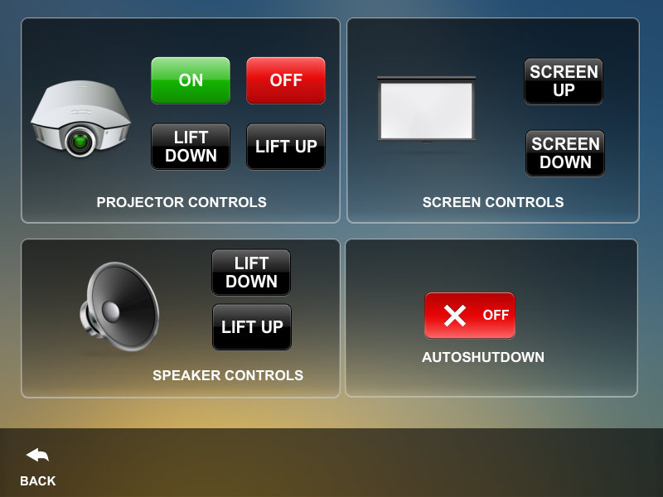
Setup Page
Controls the Power to the Projector in the Room
Raises and Lowers the Projection Screen
Raises and Lowers the Projector Lift
Enables and Disables the Auto Shutdown Routine
Press this to close the Setup Page
After Pressing the Setup Button, the Setup Page will appear. Here you can control the Projector Power, The Projector Lift, and the Projection Screen, and the Auto Shutdown Routine. Here you can enable/disable the Auto Shutdown, Turn on and off the Projector, and Raise and Lower the Projection Screen and Lift.

Slide 6
HDMI Page
HDMI Input Source Button
After Pressing the HDMI Button, the HDMI Page will appear. This will cause the Wall Plate HDMI input to appear on the Projection Screen.

Slide 7
VGA Page
VGA Input Source Button
After Pressing the VGA Button, the VGA Page will appear. This will cause the VGA Wall Plate input to appear on the Projection Screen.

Slide 8
Air Media Page
Air Media Source Button
After Pressing the Air Media Button, the Air Media Page will appear. This will cause the Air Media input to appear on the Projection Screen. Use the IP Address and Meeting Code to show your Laptop and/or IPAD on the Projection Screen

Slide 9
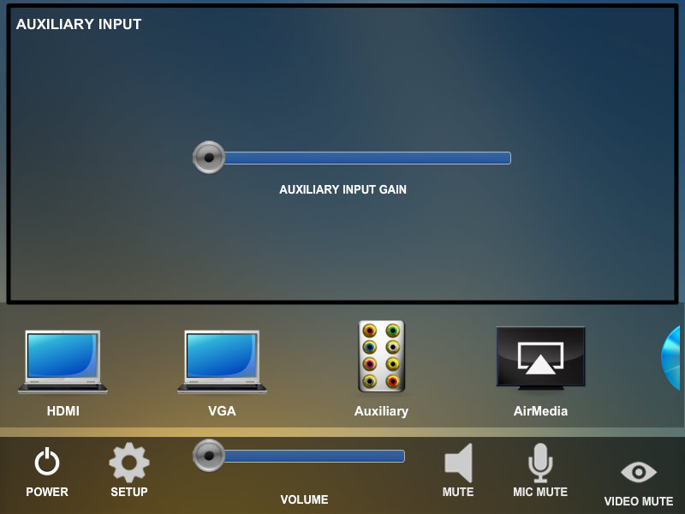
Aux Input Page
Aux Input Source Button
After Pressing the Auxilliary Button, the Auxillary Input Page will appear. This will allow the Line Inputs at the Front of the Room to be heard. It will not change what is currently on the Projection Screen.

Slide 10
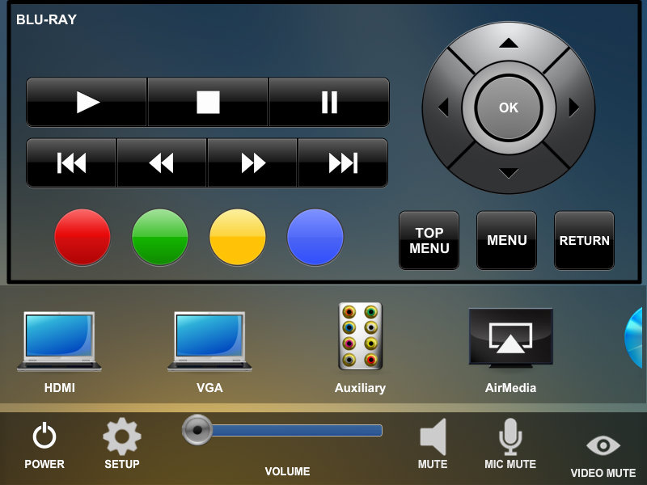
Blu-Ray Page
Menu Buttons
Standard Blu-Ray Controls
VTC Source Button
After Selecting the Blu-Ray Button, The Blu-Ray Page will appear. This will allow you to play a Blu-Ray, and control the Menus on the Blu-Ray without using the Hand Held Remote.

Slide 11

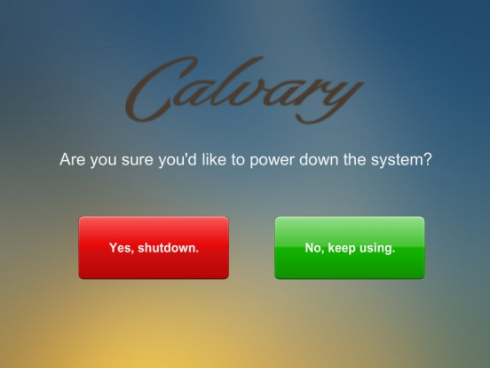
Power Down Page
From the Main Page press the Power button.
Then press the “Yes, Shut Down” button to turn the system off.

Slide 12
Service Resource Guide
Monitor is on but no image
Are all cables properly connected
Is laptop output toggled on?
Is the device turned on?
Call our office for service (336) 714-0564
I see the image but hear no sound
Check the “mute” button
Select and press volume up then volume down
Has someone turned the amplifier off at the rack
Call our office for service (336) 714-0564

Slide 13
Service Resource Guide
Nothing works
Was system power turned on from the touch panel power page?
Was there a recent power failure or surge. Check the power at the rack. Insure the power cord is plugged in?
Turn the rack off (Unplug the rack, then re-plug). The system may need to be re-set wait 90 seconds then try the touch panel.
Call our office for service (336) 714-0564

Slide 14
For Service, contact:
Tonya Allen at
(336) 714-0564 tonyaa@strategicmail.net

Slide 15
For Sales Contact:
Len Miller at (336) 714-0529
LenM@strategicmail.net

